Slide 1
Networks and the Internet
What is the Web?
  Billions of documents, called Web pages, available to anyone connected to the Internet
A Web site is
a collection of
related Web pages
You can share
information by
creating Web pages
or posting photos on
a photo sharing
community
A podcast is
recorded audio
stored on a Web
Site that can be
downloaded
A Web page contains
text, graphics, audio,
video, and links to
other Web pages
A blog consists of time-
stamped articles in
a journal format
Click to view
Web Link,
click Chapter 1,
Click Web Link
from left navigation,
then click Blogs below Chapter 1

Slide 2
Computer Software
What is software?
Consists of a series
of instructions that
tells the computer
what to do
Also called a
program
Click to view Web Link,
click Chapter 1, Click Web Link
from left navigation,
then click Computer Programs below Chapter 1

Slide 3
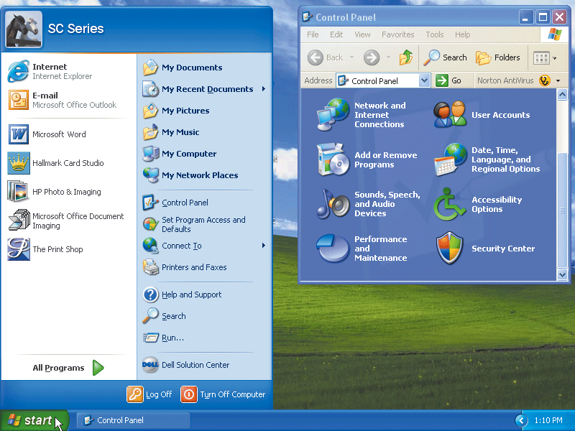
Computer Software
What is a graphical user interface (GUI)?
  - Allows you to interact with the software using graphics and icons
  - Controls how you enter data and how the screen displays information

Slide 4
Computer Software
What is system software?
  Programs that control or maintain the operations of the computer and its devices
Operating System (OS)
is a set of programs
that coordinates all
activities among
computer hardware
devices and allows
users to run
application software
Utility Programs allow the user to
perform maintenance-type tasks
usually related to managing a
computer, its devices or its programs

Slide 5
Computer Software
What is application software?
  Programs that perform specific tasks for users
Word
Processing
Spreadsheet
Database
Presentation
Graphics
Click to view Web Link,
click Chapter 1, Click Web Link
from left navigation,
then click Application Software below Chapter 1

Slide 6
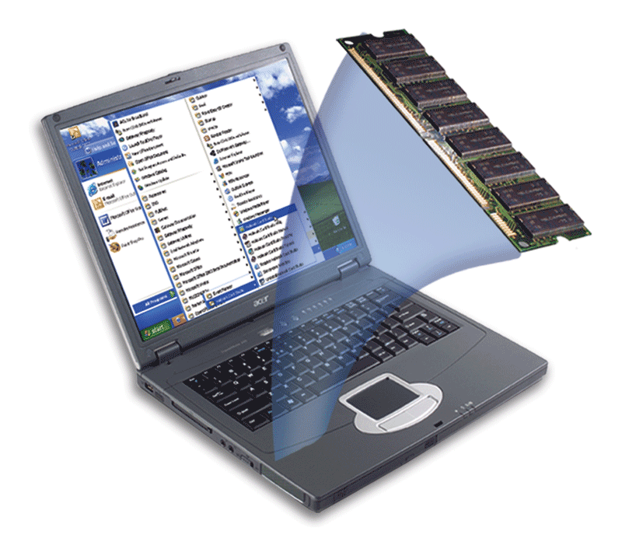
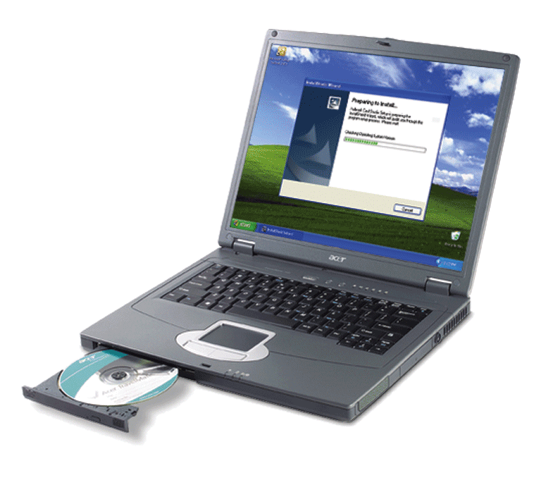
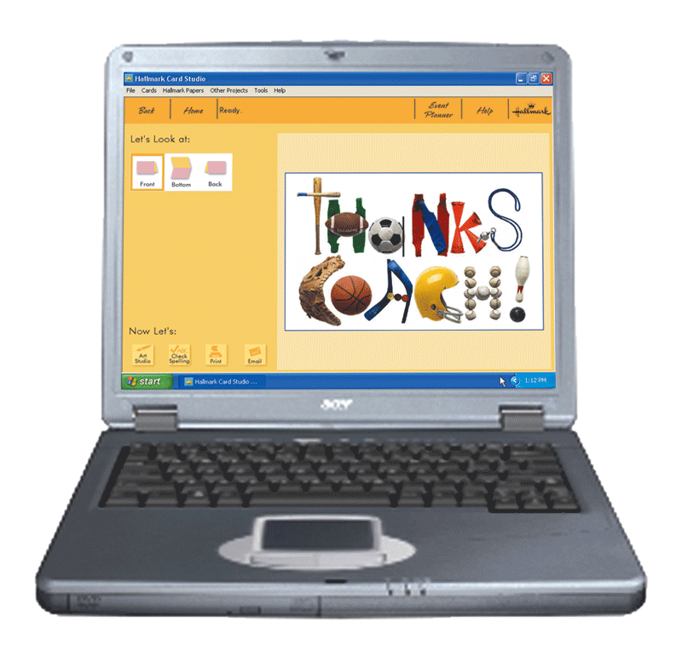
Computer Software
How do you install and run programs?
Step 1: INSTALL
When you insert a greeting card program disc in the CD drive for the first time, the computer begins the procedure of installing the greeting card program on the hard disk.
Step 3: USE
The greeting card program executes. Using this program, you can create custom greeting cards.
Step 2: RUN
Once installed, you can instruct the computer to run the greeting card program. The computer transfers instructions from the hard disk to memory.

Slide 7
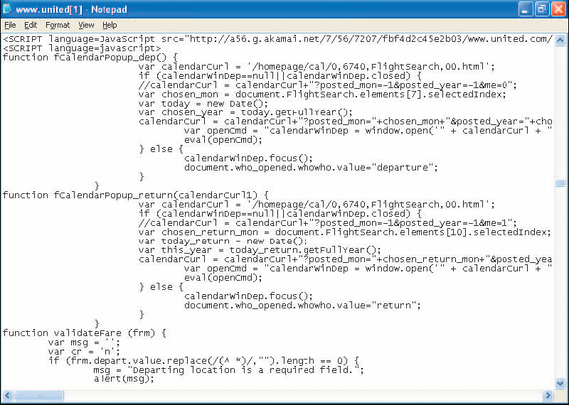
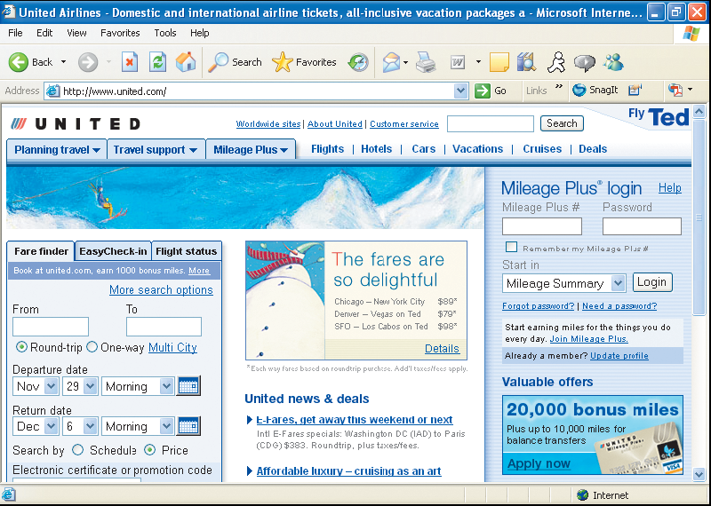
Computer Software
JavaScript
What is a programmer?
  - Someone who develops
  application or system software
    - Programmer writes
    the instructions to
    direct the computer to
    process data into
    information
Web application

Slide 8
Categories of Computers
What are the categories of computers?
Personal Computers
(desktop)
Mobile Computers and
Mobile Devices
Game Consoles
Servers
Mainframes
Supercomputers
Embedded Computers

Slide 9
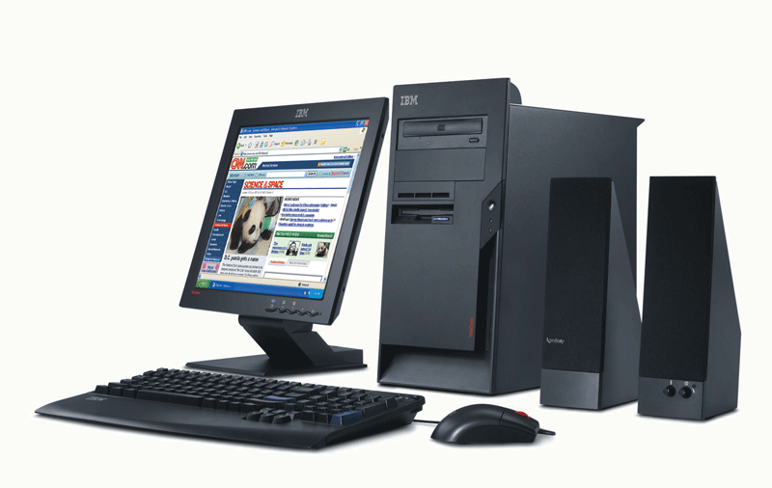
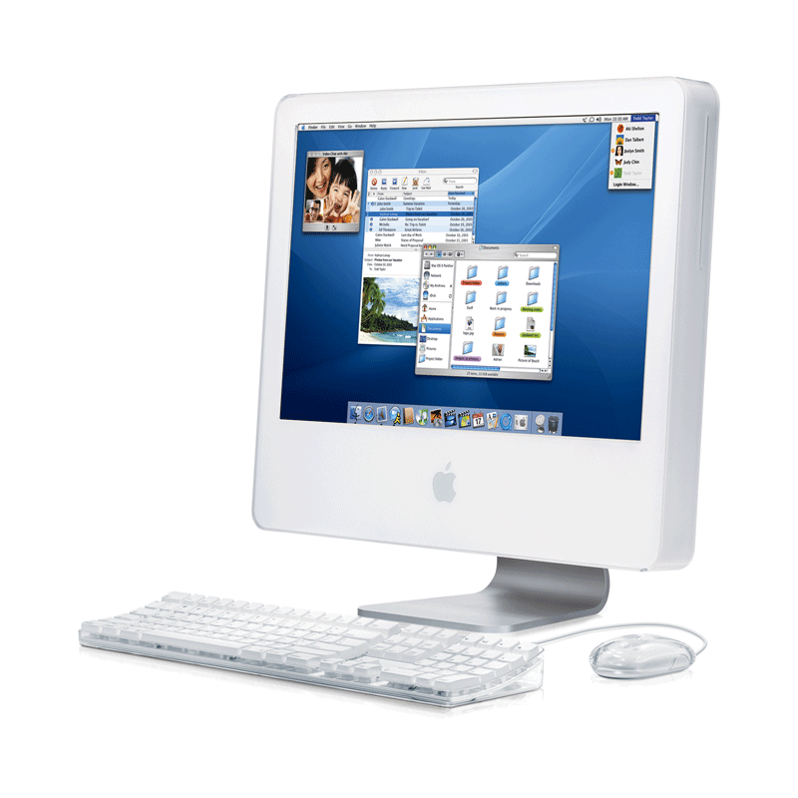
Personal Computers
What are the two most popular series of personal computers?
Apple Macintosh uses the Macintosh operating system (Mac OS)
PC and compatibles use the Windows operating system
Click to view Web Link,
click Chapter 1, Click
Web Link from left
navigation, then click Personal Computers below Chapter 1

Slide 10
Personal Computers
What is a desktop computer?
  Designed so all of the components fit entirely on or under a desk or table

Slide 11
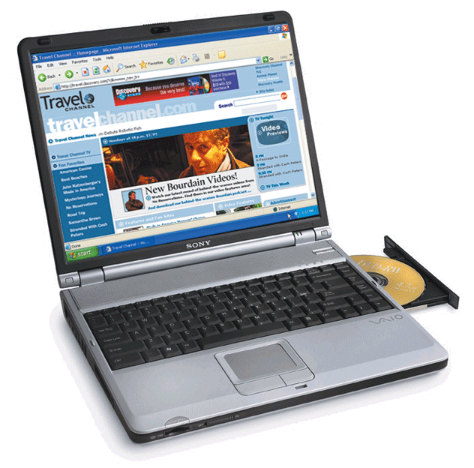
Mobile Computers and Mobile Devices
What is a notebook computer?
  - Portable, small enough to fit on your lap
  - Also called a laptop computer
  - Generally more expensive than a desktop computer

Slide 12
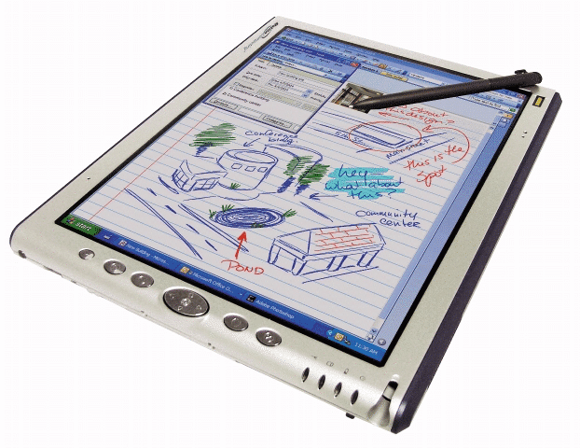
Mobile Computers and Mobile Devices
What is a Tablet PC?
  Resembles a letter-sized slate
  Allows you to write on the screen using a digital pen
  Especially useful for taking notes

Slide 13
Mobile Computers and Mobile Devices
What are mobile devices?
- Small enough to carry in a pocket
- Internet-enabled telephone is a "smart telephone"

Slide 14
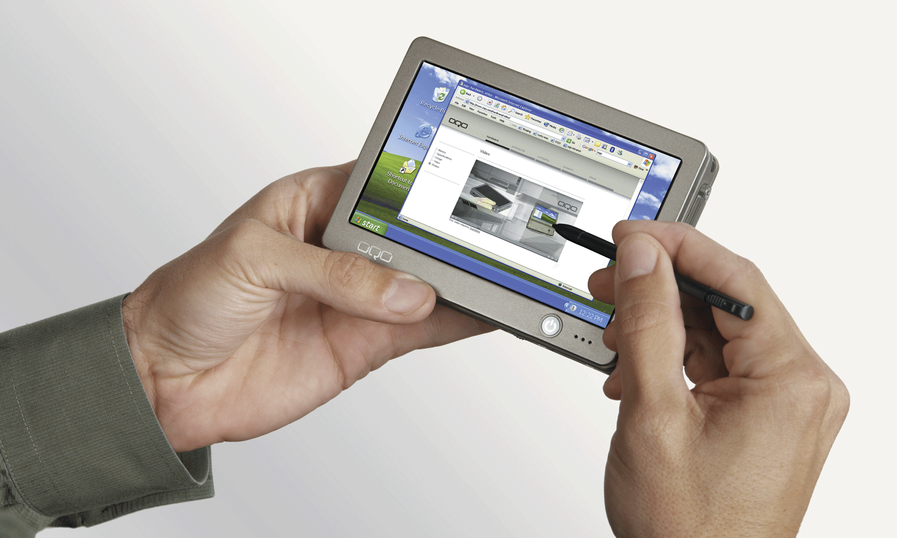
Mobile Computers and Mobile Devices
What is a handheld computer?
Used
by mobile employees such as meter readers and delivery people
Small
enough to fit
in one
hand

Slide 15
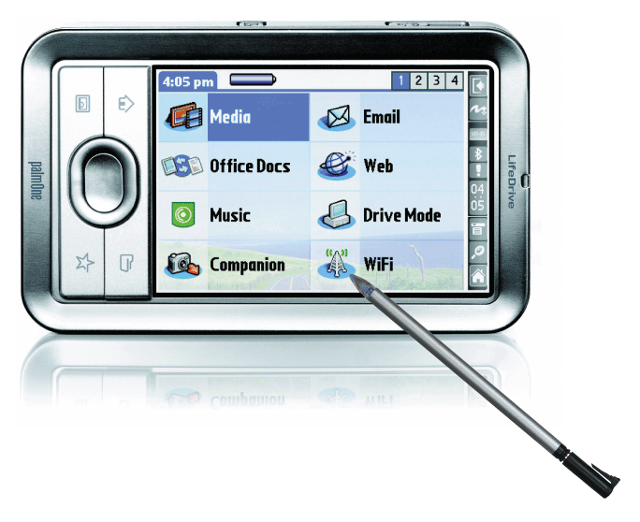
Mobile Computers and Mobile Devices
What is a personal digital assistant (PDA)?
  - Provides personal organizer functions
    Calendar
    Appointment book
    Address book
    Calculator
    Notepad

Slide 16
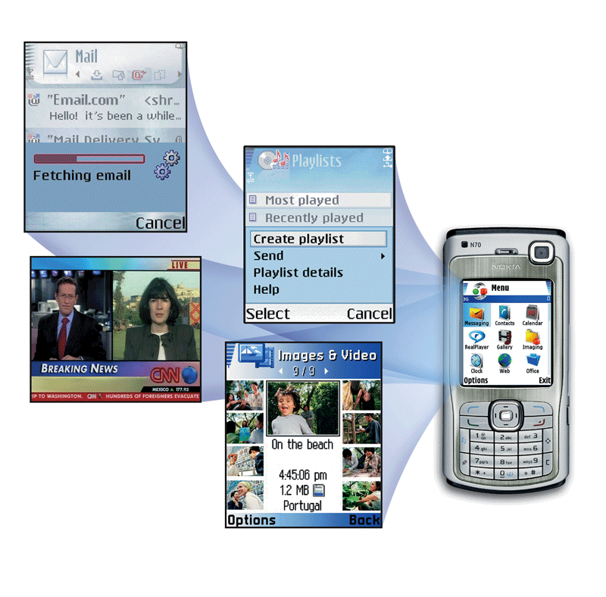
Mobile Computers and Mobile Devices
What are smart phones?
A smart phone is
an Internet-enabled
telephone that usually
provides PDA capabilities

Slide 17
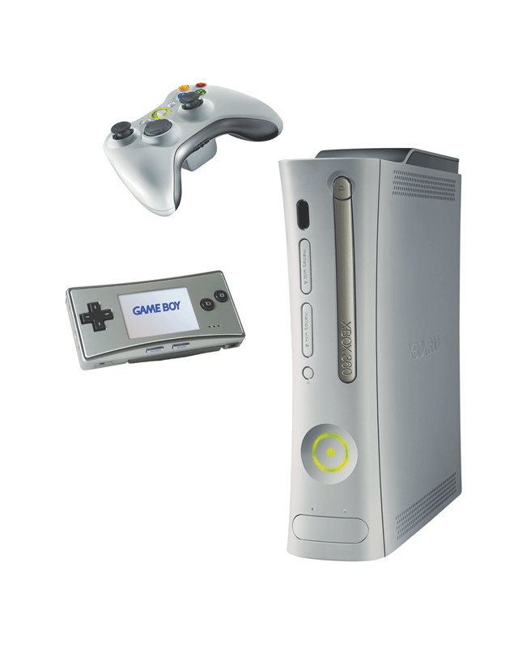
Game Consoles
What are game consoles?
Mobile computing device designed for single-player or multiplayer video games

Slide 18
Servers
What types of servers are there?
A server controls access to network resources and provides centralized storage
Mainframe Very powerful, expensive computer that supports thousands of computers
Supercomputer The fastest, most powerful, most expensive computer. Used for applications requiring complex mathematical calculations

Slide 19
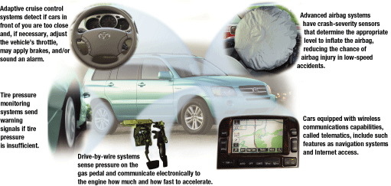
Embedded Computers
What is an embedded computer?
  A special-purpose computer that functions as a component in a larger product

Slide 20
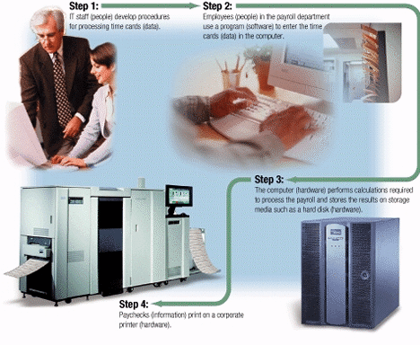
What are information system elements?
  - Hardware
  - Software
  - Data
  - People
  - Procedures

Slide 21
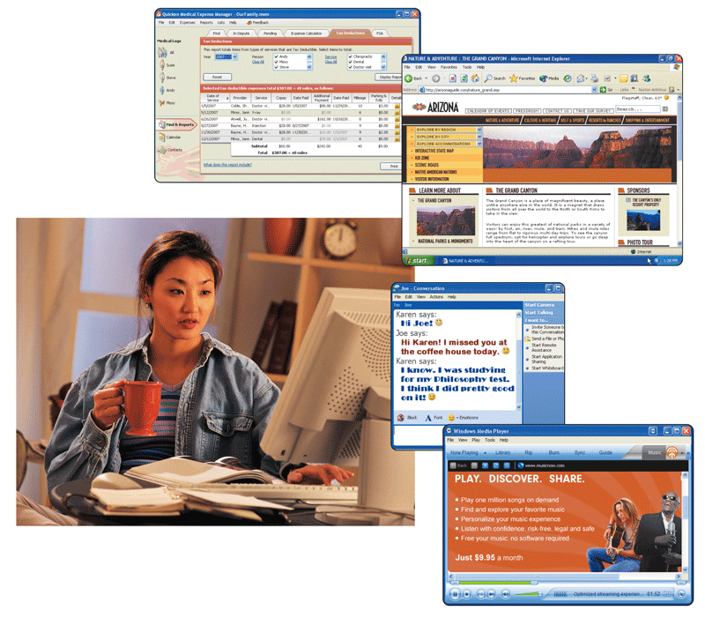
Examples of Computer Usage
What software is available for a home user?
  - Personal finance management
  - Web access
  - Communications
  - Entertainment

Slide 22
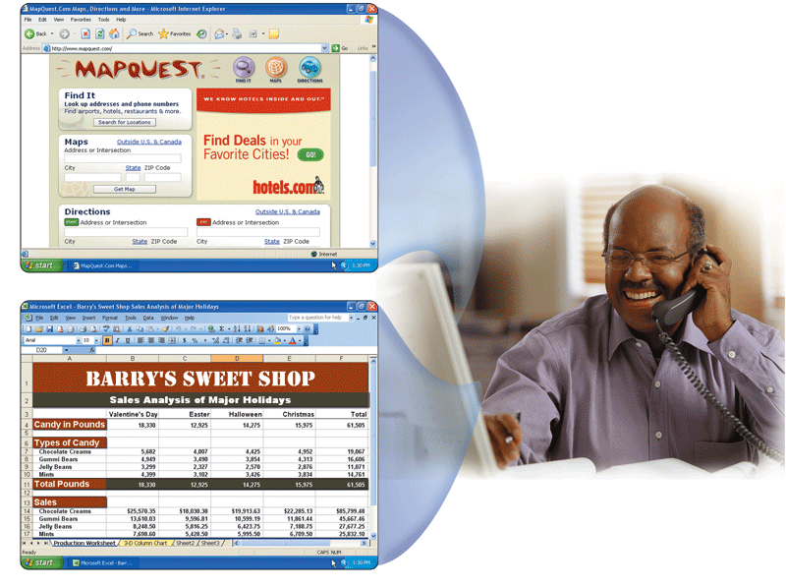
Examples of Computer Usage
What software is available for a small office/home office (SOHO) user?
  - Productivity software
  - Specialty software
  - Web usage
  E-mail

Slide 23
Examples of Computer Usage
What is available for a mobile user?
  Hardware
    Notebook computers
    PDAs
    Smart phones
    Tablet PCs
  Software
    Word processing
    Spreadsheet
    Presentation graphics software

Slide 24
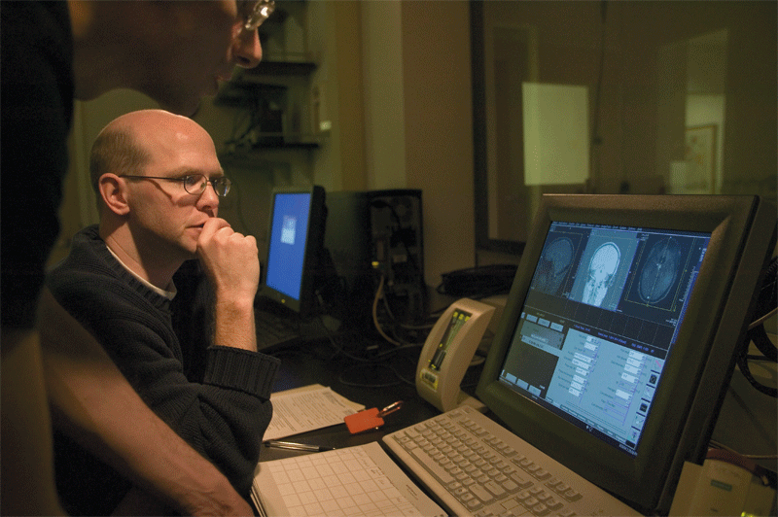
Examples of Computer Usage
What are the needs of a power user?
  - Speed and large amounts of storage
  - Types of power users
    Engineers
    Scientists
    Architects
    Desktop publishers
    Graphic artists

Slide 25
Examples of Computer Usage
What are the needs of the large business user?
  Payroll
  Inventory
  E-commerce
  Desktop publishing
Click to view Web Link,
click Chapter 1, Click
Web Link from left
navigation, then click Enterprise Computing below Chapter 1

Slide 26
Computer Applications in Society
What are some examples of computer applications in society?
  Education
  Finance
  Government
  Healthcare
  Science
  Publishing
  Travel
  Manufacturing

Slide 27
Summary of Introduction to Computer
Basic computer concepts
The term, computer
The advantages and disadvantages of using computers
The components of a computer
The purpose of a network
The uses of the Internet
Computer software
Categories of computers
Types of computer users
Computer applications in society

